Slide 1







CSE-404
Correlation of Air Quality and Air-borne Diseases and Prediction of Disease Burden Using Machine Learning

Slide 2





GROUP NO - A2
Our Group Members
Bijoya Ghosh
Ellora Yasi
Khaled Hasan Irfan
Easin Arafat
Tariq Hasan Rizu
202014009
202014012
202014019
202014049
202014058

Slide 3

Idea Overview
Air pollution poses a significant global public health concern, leading to a rise in respiratory and cardiovascular diseases. This project aims to develop a machine-learning model for predicting disease burden rate and analyzing the correlation between air quality and airborne diseases. By leveraging recent data, we will investigate the relationship between air quality graphs and the manipulation of disease occurrence, while exploring machine learning approaches to analyze and mitigate the impact of air pollution on public health.
Features(Input Columns):
'Location', 'Year', 'Measure', 'Gender', 'Cause', 'PM Concentration'
Target(Output Column):
'Rate Per 100000 Population'

Slide 4
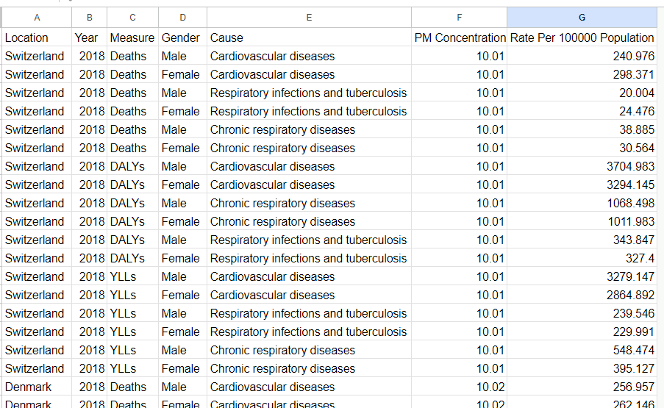
Figure- This image representing our Dataset here column Rate Per 100000 Population is our target colunm

Slide 5
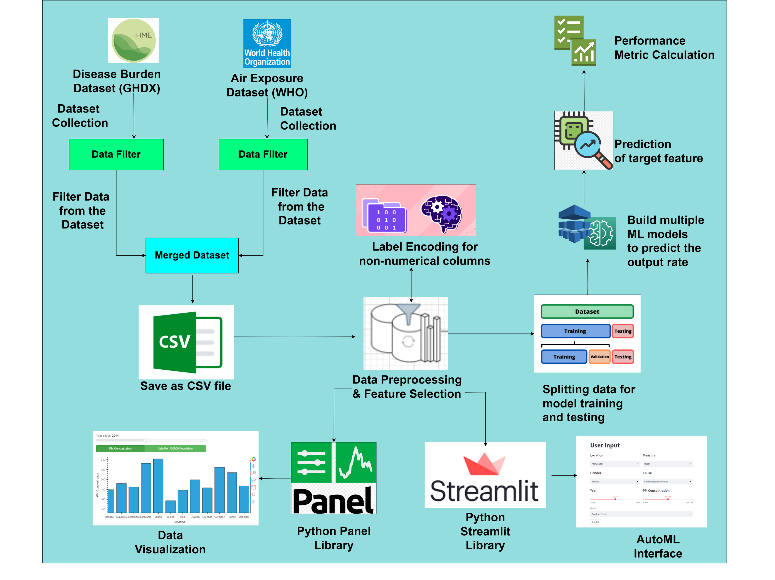
Project
Pipeline

Slide 6
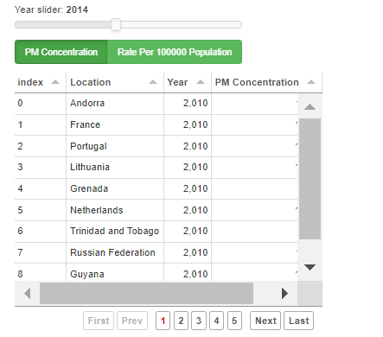
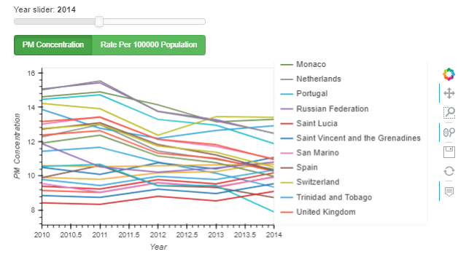
Dataset Overview
Figure-Line plot for the PM Concentration on different countries at each year
Figure-Data of annual PM Concentration for different countries of a selected year

Slide 7
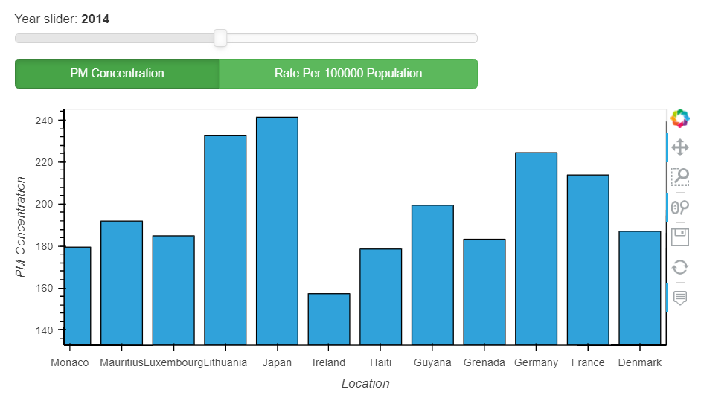
Dataset Overview
Figure-Bar chart for the PM Concentration of relevant countries in the selected year

Slide 8

Implementation:
Data Collection & Preprocessing.
Feature Selection & Engineering.
Model Training & Evaluation.
Model Fine-tuning and Selection
Notebook/Google Drive Link:
https://drive.google.com/drive/folders/12xkWpHWOoa5IO-oxBzOqYlfqzYE0LKu-?usp=sharing

Slide 9
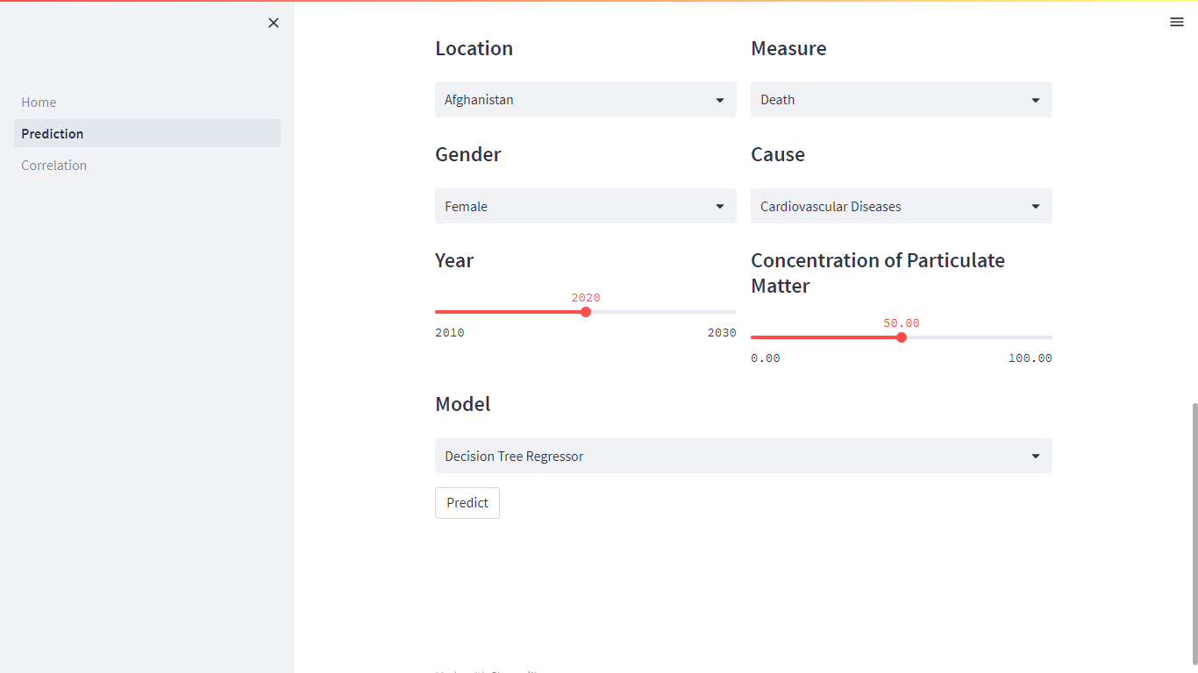
Demonstration

Slide 10


Evaluation Metrics
ALGORITHM | R2_SCORE | MEAN SQUARED ERROR | MEAN ABSOLUTE ERROR
Random Forest Regressor Model | 0.9624 | 286035.27 | 179.87
Decision Tree Regressor Model | 0.9484 | 393319.50 | 139.01
Light GBM | 0.8337 | 1295016.35 | 669.57
GradientBoostingRegresson | 0.5577 | 3372184.01 | 1054.37
MLPRegressor | 0.5015 | 4262390.08 | 1158.53
PolynomialRegression | 0.5003 | 3809641.68 | 1075.67
Linear regression Model | 0.0711 | 7082953.73 | 1787.75

Slide 11

Discussion
Achievements: Identified correlations between air quality and air-borne diseases, enabling a better understanding of their relationship.
Predictive Model: Developed accurate machine learning models to predict disease burden based on air quality factors and other input columns.
Potential Improvements: Further research can explore additional features like demographic data to enhance prediction accuracy.
Public Health Impact: Findings can inform public health interventions and policies to mitigate disease burden related to air pollution.

Slide 12


Idea for Paper Publication
Our project offers novel insights into the correlation between air quality and air-borne diseases.
Emphasizing the development of predictive models for disease burden using machine learning.
Highlighting the practical implications of the findings and potential policy interventions.
Considering publishing in reputable interdisciplinary journals focusing on environmental health or public health informatics.

Slide 13



Slide 14

Any Questions?

